Slide 1
PROJECT DOOR STEP
Panama-Global Liquids
Office Visit- May 18, 2000
Reported- August 21, 2000
Confidential

Slide 2
Project Doorstep-Panama
Review Highlights
Project Objective:
We performed an on-site review of processes, procedures and controls that support the trading and origination business activities within the Panama Global Trading office. Our procedures included interviewing Suzanne Clapp. We also performed a test of commodity transactions from deal execution through settlement.
Team Members: Office Personnel Interviewed:
Scott Earnest - Risk Management Suzanne Clapp - Office Manager
Tom Moran - Credit
John Vickers - AA

Slide 3
Project Doorstep-Panama
Current Portfolio
Liquids
Panama office set up to take advantage of favorable tax laws for
transactions which are traded off-shore.
Transaction types include sales of bunker fuels, machinery diesel fuel
other transactions originated to take advantage of the favorable tax laws.
Global products also provides fuel management services for
Enron Caribbean basin operations of the Ege-minsa Power Plant.
Most deal are spot (less than three months).
Largest and longest dated position is the Ege-minsa position (150Kbbls per month through Dec 01).
Storage Leases with Petro-Terminal De Panama provide 2.7mmbbls (3x800Kbbls & 3x120bbls) of capacity to support trading activity.
6-30-00
NOP SCOTT
V@R SCOTT
YTD P/L SCOTT

Slide 4
Project Doorstep - Panama
Observations
EFFECTIVE CONTROLS
Reconciliation of Ege-minsa plant volumes occurs in Houston
Legal and Credit review all contracts
Suzanne is fluent in speaking Spanish and is “Enronized” (10+ yrs in Liquids Group)
Houston manages risk books and prepares confirms
Cash is controlled out of Houston

Slide 5
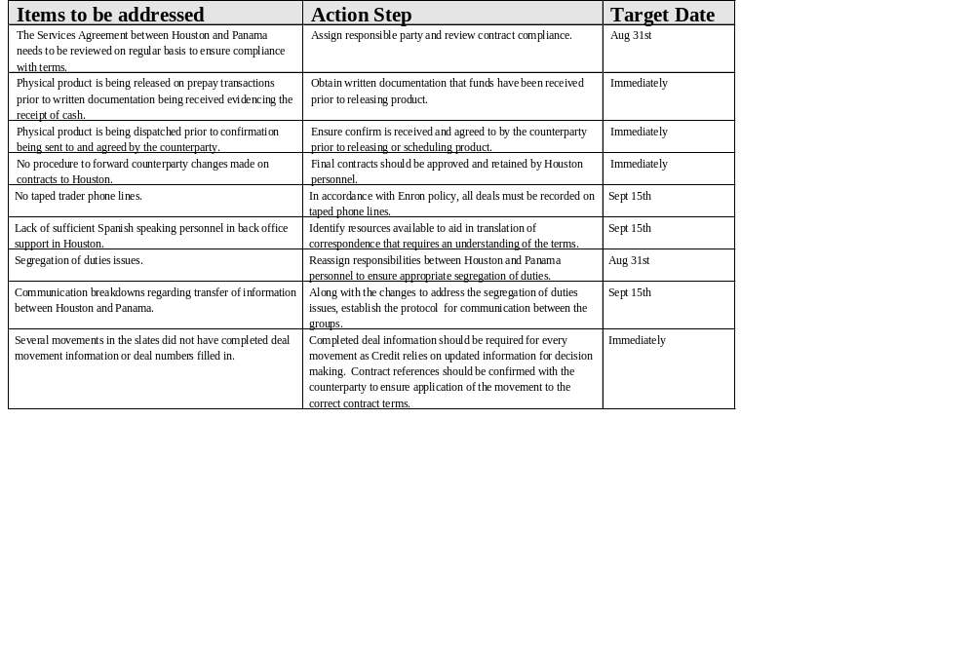
Project Doorstep - Panama Observations

Slide 6
Project Doorstep - Panama
Observations
OUTLOOK
As prices move from contango to backwardation, more bunker fuel will be sold.
Begin to use storage as a strategic component in world-wide liquids trading.
EI is trying to develop a power trading market with the aid of the power positions created by ventures involving physical plants

